Slide 1
Supervised Learning Part 1 – Intro to Automatic Machine Learning
Ranon (Advanced Analytics)

Slide 2

Part 3 Agenda
What is autoML
Evaluating AutoML’s functionality
Limitations of AutoML
Exploring Open-sourced Frameworks
Code Walkthrough

Slide 3
What is AutoML?

Slide 4
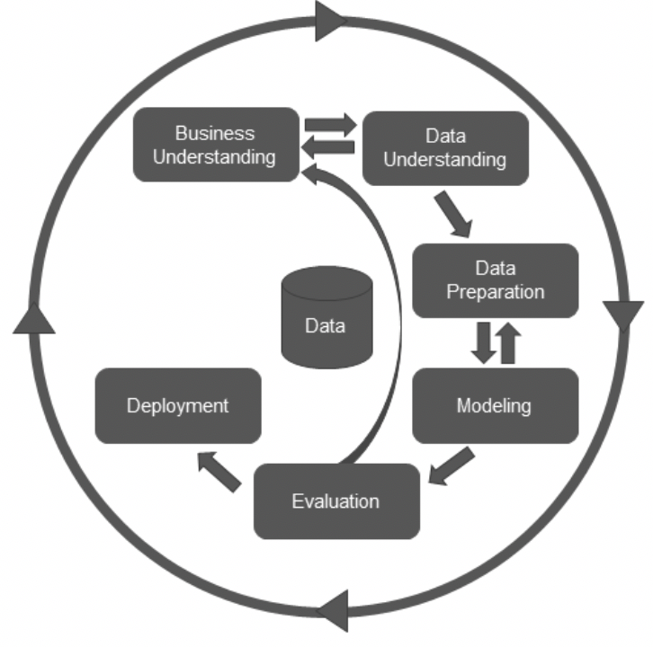
A means to save time and effort on repetitive tasks in ML pipelines
What is it?
Save on
Time taken to preprocess data
Time taken for feature selection / elimination
Time taken for Model Selection
Time taken to optimize model performance through hyperparameter tuning

Slide 5
How it came about?
Between 1995 to 2015
Between 2013 to present
Many ML Libraries were developed
Substantial human expertise required to extract best ML model performance
Automating ML Tasks came about
E.g. Sckit-Learn,Spark Mllib,Tensorflow,Keras
Good intuition, experience, and many tedious manual tasks to tune algorithmic parameters.
Different solutions emphasizing different aspects of the ML pipeline

Slide 6
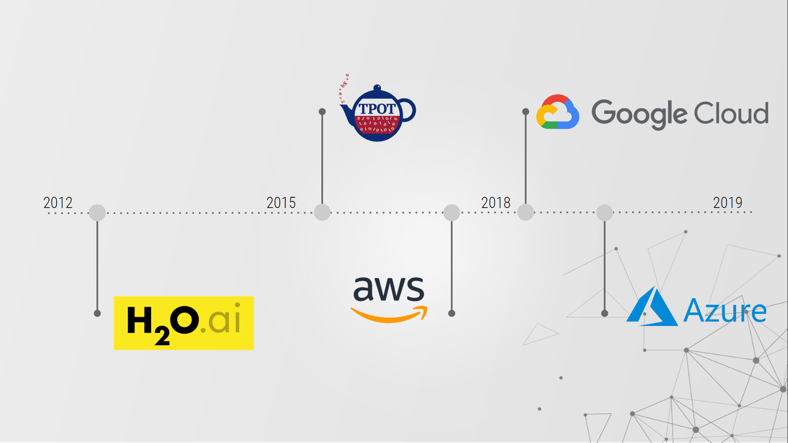
Development Timeline
Between 1995 to 2015
Between 2013 to present
Many ML Libraries were developed
Substantial human expertise required to extract best ML model performance
Automating ML Tasks came about
E.g. Sckit-Learn,Spark Mllib,Tensorflow,Keras
Good intuition, experience, and many tedious manual tasks to tune algorithmic parameters.
Different solutions emphasizing different aspects of the ML pipeline

Slide 7
Different levels of automation
Level 1 (Simplest)
Level 2
Level 3
Code out your own ML algorithms
Use high-level algo APIs. Sklearn / Keras / Pandas/ XGBoost / H2O etc.
Auto Hyperparameter tuning / ensembling / basic model selection
(ain’t going here)
People who participate on Kaggle tend to be here.
Different solutions emphasizing different aspects of the ML pipeline
Level 6 (Impossible?)
Level 5
Level 4
Full ML automation. Solving hard problems without any input and guidance from the human
Automatic domain and problem specific feature engineering, data augmentation and data integration
Automatic Feature selection, Feature Engineering, introduction of GUIs to perform ML
Difficult to achieve without human intervention
Use technical aspect of the features to perform feature engineering e.g. e.g. label encoding / target encoding / binning of features
(May not be possible)

Slide 8
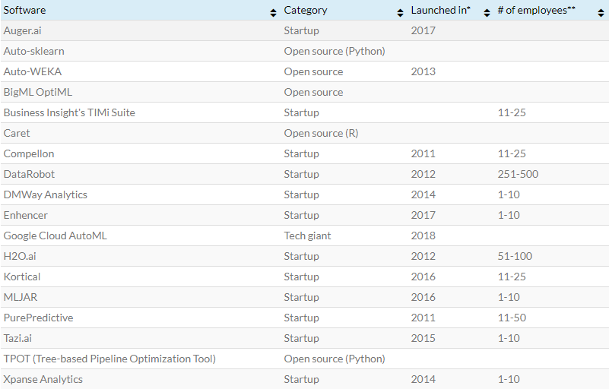
What are the available automl platforms?
Open Source
Require active development environment in Python or R and require the user to write at least a few lines of code to initiate the automated machine learning process.
Startups (commercial)
Offer tools that can be launched with a clean user interface by a non-technical user. Some tools also offer visualization to explain their findings and the resulting model.
Tech giants (commercial)
IBM / AWS / GOOGLE etc. Aim to provide a whole suite of functionalities. Usually paid.
You can also split your content
Your audience will listen to you or read the content, but won’t do both.
Reference: https://blog.aimultiple.com/auto-ML-software/

Slide 9
Evaluating AutoML’s functionality

Slide 10
What are the available ML functionalities provided by the current platforms?
Data Preprocessing. Feature Engineering
Model Selection, Hyperparameter Tuning, Architecture Search
Model Interpretation and prediction analysis
The first task in an ML pipeline
Not handled very well by any AutoML tools and requires human intervention
The most well-covered aspect of the ML pipeline.
Different tools employ different algorithms to select the best models and tune their hyperparameters
Well supported by commercialized tools only
Provides detailed result representation through model dashboards, feature importance and different visualization methods
Notes:
Point 2 : Each tool supports a collection of existing machine learning algorithms to build models.
Different algorithms/architectures are used to select the best models
Different search methods are applied for hyperparameter tuning e.g. Grid/Random/Bayesian Search

Slide 11
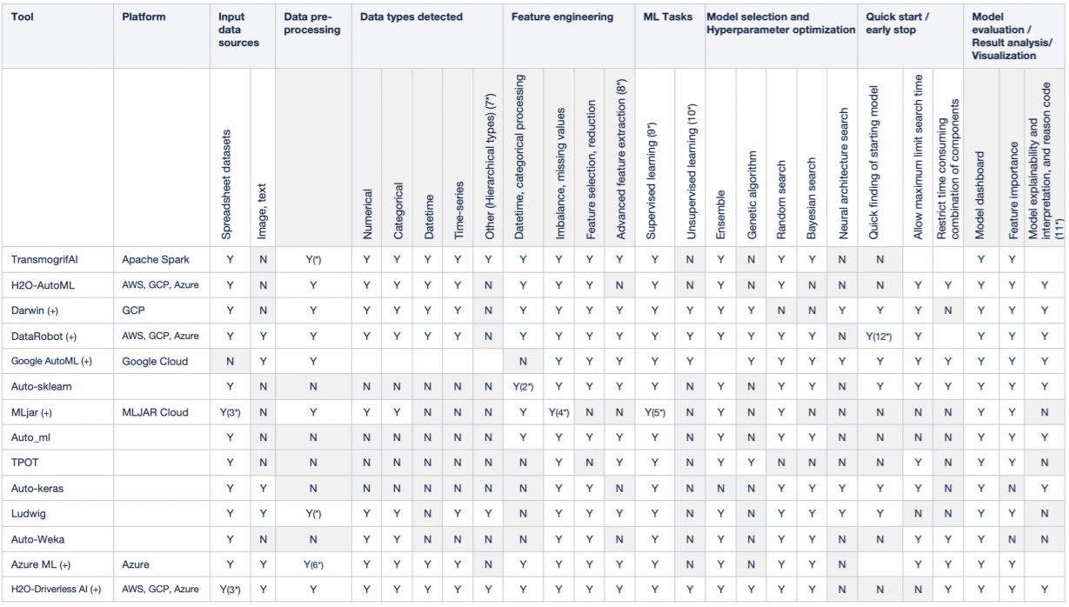
Comparison of functionalities for AutoML tools

Slide 12
Evaluating AutoML’s performance

Slide 13
Process to evaluate AutoML performance
Identify Business Requirements
Identify Evaluation Criteria
Design hypotheses/experiment(s) to perform comparison
Stakeholder Objectives (e.g. max time savings)
Costs
Technology Stack
Available Skillsets
Predictive Performance
Computational Cost
Time Savings
Usability
Datasets to use
Nature of Problems
Performance Metrics
Hardware choice & Resource Specifications
AutoML Frameworks and their configuration/set-up
Comparison against non-AutoML solutions
References
2018: https://arxiv.org/pdf/1908.05557.pdf
2019: https://arxiv.org/pdf/1808.06492.pdf
https://www.statworx.com/ch/blog/a-performance-benchmark-of-different-automl-frameworks/
Notes:
Point 2 : Each tool supports a collection of existing machine learning algorithms to build models.
Different algorithms/architectures are used to select the best models
Different search methods are applied for hyperparameter tuning e.g. Grid/Random/Bayesian Search

Slide 14
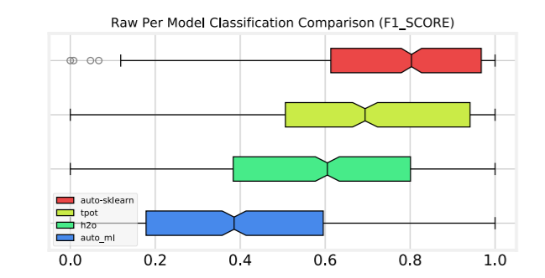
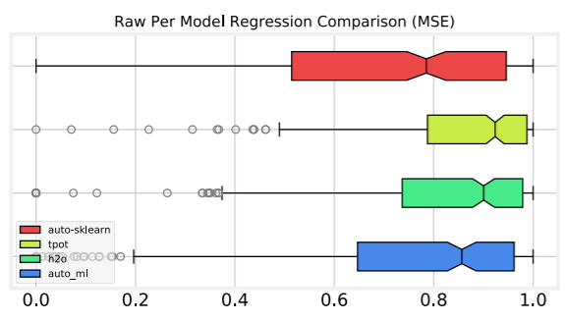
How do open-sourced autoML tools stack up against each other?
Classification
Regression
These figures show the median performance (center line), quartiles (box and whisker), and 95% median confidence range (notch in box), and potential outliers (grey circles) for each framework tested.
Reference: https://arxiv.org/pdf/1808.06492.pdf

Slide 15
Limitations of AutoML
Reference: https://hbr.org/2019/10/the-risks-of-automl-and-how-to-avoid-them

Slide 16
Limitations of AutoML
Semi-automation of the model development process
Without proper expertise, contextualization, and data complementarity, AutoML is unlikely to produce the desired results
AutoML solutions have not yet reached a fully automated stage
Various tools exists but have limited usability (especially open-sourced ones)
Hyperparameter tuning
Black Box models
Poor Feature engineering
Out of the box hyperparameter tuning cannot handle domain specific peculiarities within the data. Intuition of which parameters to tweak
Technical FS / Model Selection etc. may result in poor interpretability of model
Unable to get additional supplementary data / perform data augmentation and integrate it within the pipeline
Conclusion
AutoML Is better used as a complementary tool to human experts, freeing them to engage in more value-add activities that leverage their combination of domain and technical knowledge.

Slide 17
Exploring Open-sourced Frameworks

Slide 18
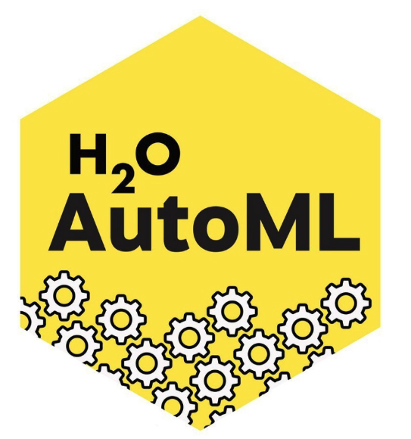
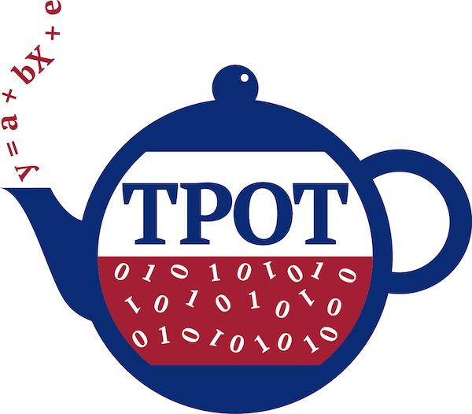
2 Popular Python based Open-sourced Frameworks

Slide 19
Feature Comparison
Frameworks | H2O AutoML | TPOT
Features | Supports imputation, one-hot encoding, standardization for feature engineering, model selection and tuning | Supports model selection and tuning
Backend Framework | Prioprietary | Scikit learn
Outputs | Ensemble model that can be saved and reloaded into the h2o framework to be used in production systems or exported for separate use Model Dashboard and Feature importance | Export a sklearn pipeline to code to be further modified by hand
API Language Support | Python, R, Scala and a web GUI | Python
Platforms Supported | Hadoop, Spark, AWS, your laptop | Laptop
Time to run | Can be customized by adjusting parameters. Time to convergence might vary depending on hardware and model performance requirements
Notes:
Resource link: https://h2o-release.s3.amazonaws.com/h2o/master/3888/docs-website/h2o-docs/downloading.html

Slide 20
Limitations
Frameworks | H2O AutoML | TPOT
Resource Usage | Memory Intensive | Low
Preprocessing convenience | - | Features need to be numerically encoded before parsing
Explainability | Workaround required to obtain Shap Values | -
Problem Type | Only supervised Problems Works better for classification problems | Only supervised Problems Works better for regression problems

Slide 21
Documentation: http://docs.h2o.ai/h2o/latest-stable/h2o-docs/automl.html

Slide 22
H2O AutoML process
Trains a Random grid of algorithms
Individual models are tuned using cross-validation
Two Stacked Ensembles are trained
like GBMs, DNNs, GLMs, etc. using a carefully chosen hyper-parameter space.
Ensemble 1: contains all the models (optimized for model performance)
Ensemble 2: Best performing model from each algorithm class/family (optimized for production use).
All models can be easily exported to production
Returns a sorted “Leaderboard” of all models
Difficult to achieve without human intervention
Use technical aspect of the features to perform feature engineering e.g. e.g. label encoding / target encoding / binning of features

Slide 23
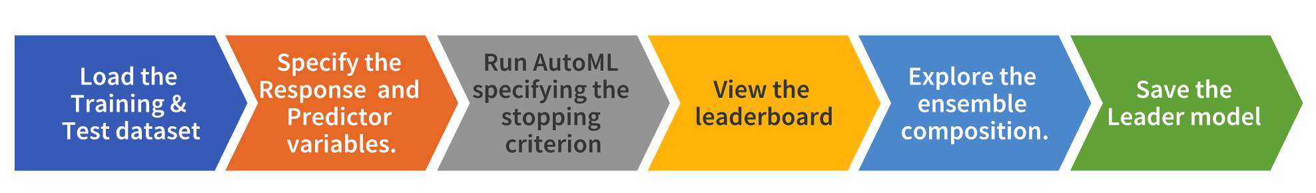
Code Walkthrough
*Open Jupyter Notebook Demo*

Slide 24
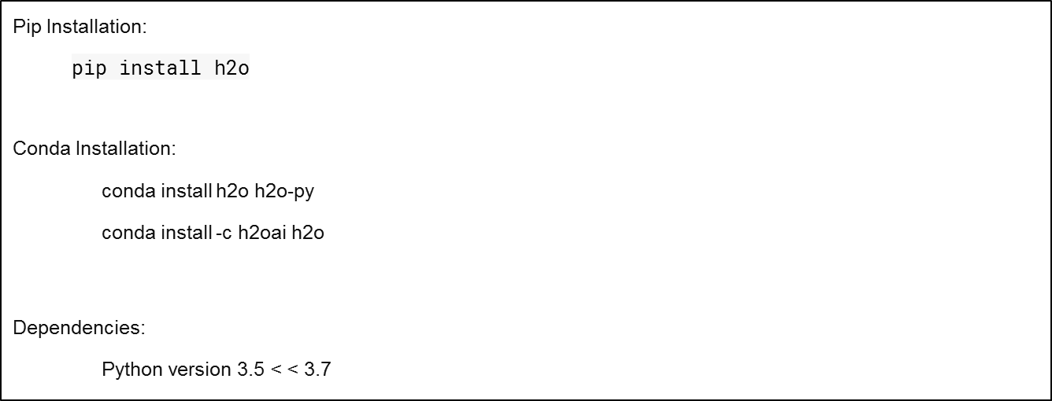
Python Installation

Slide 25
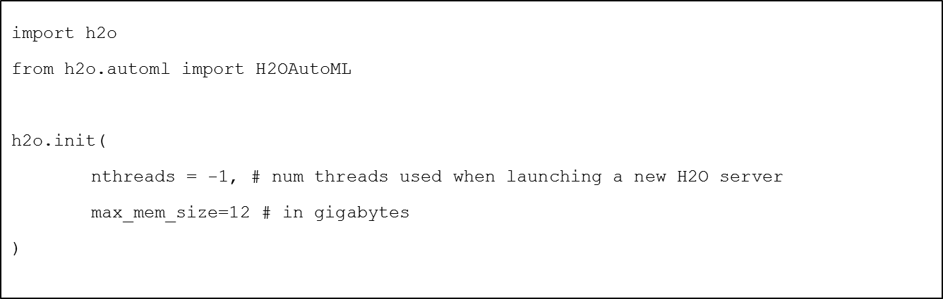
Initialize H2O
Import the h2o package and H2OAutoML class
On executing the cell, some information will be printed on the screen in a tabular format displaying amongst other things, the number of nodes, total memory, Python version, etc.. Also, the h2o.init() makes sure that no prior instance of H2O is running.

Slide 26
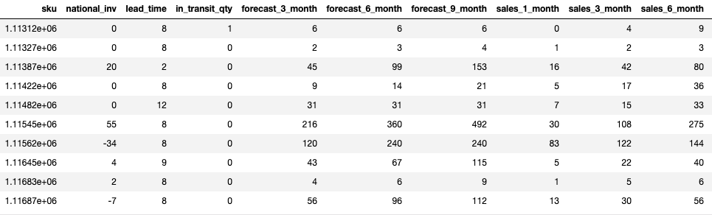
Load data into H2O
data_path = "https://github.com/h2oai/h2o-tutorials/raw/master/h2o-world-2017/automl/data/product_backorders.csv"
# Load data into H2O (as a H2O dataframe)
df = h2o.import_file(data_path)
df.head()
df.shape (19053 rows, 23 cols)

Slide 27
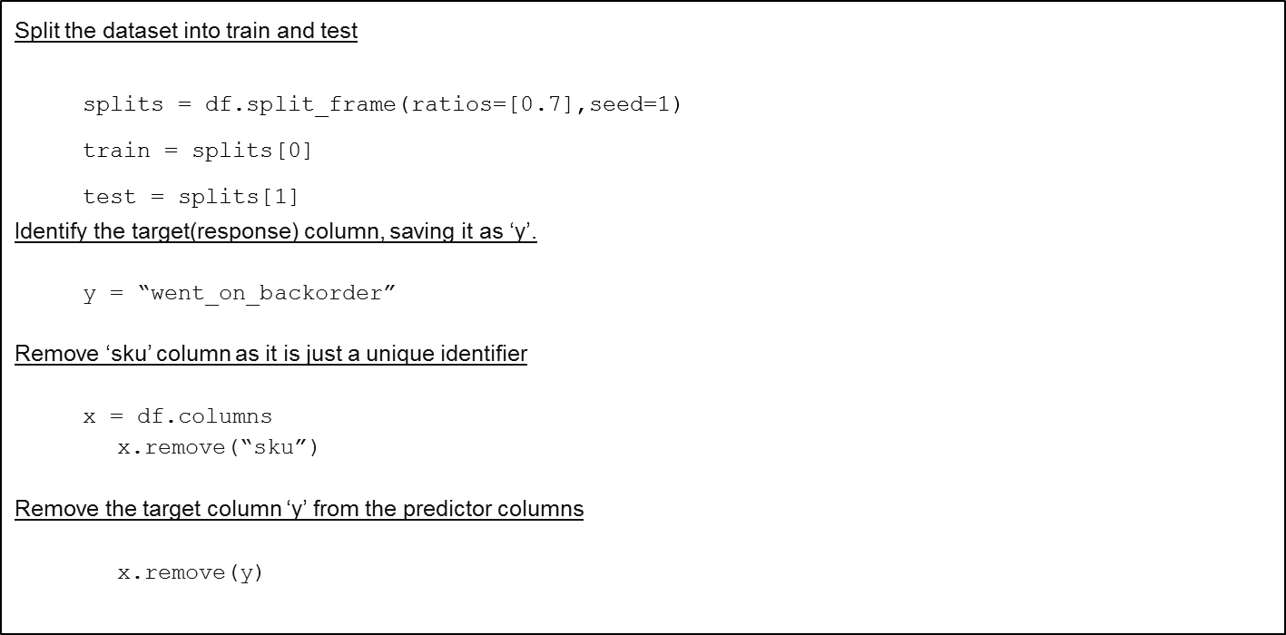
Split the data + Get features/target

Slide 28
Run AutoML ( behind the scenes for cv)
Run AutoML, stopping after 120 seconds. The max_runtime_secs argument provides a way to limit the AutoML run by time
Stopping Parameters:
There are two stopping strategies (time or number-of-model based), and one of them must be specified. When both options are set, then the AutoML run will stop as soon as it hits one of either of these limits.
max_runtime_secs: This argument controls how long the AutoML will run at the most, before training the final Stacked Ensemble models. Defaults to 3600 seconds (1 hour).
max_models: Specify the maximum number of models to build in an AutoML run, excluding the Stacked Ensemble models. Defaults to NULL/None.

Slide 29
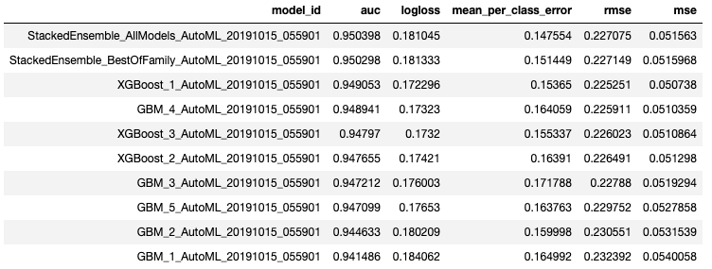
View the AutoML Leaderboard
The “leaderboard” features table of models (that were used by AutoML for training) and their performance metrics.
lb = aml.leaderboard
lb.head()
The best model is a Stacked Ensemble(placed on the top) and is stored as aml.leader
The table above shows the top 10 models built by AutoML with their parameters
The leaderboard is sorted by a default performance metric (specified internally for each type of machine learning task)
The best model is a Stacked Ensemble(placed on the top) and is stored as aml.leader

Slide 30
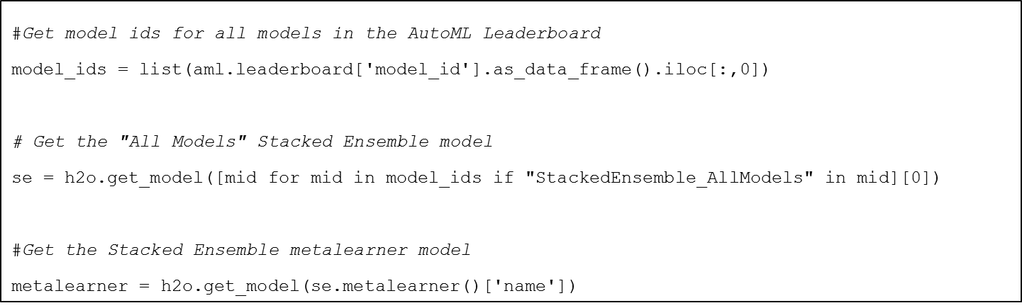
View the top model (usually stacked emsemble)
Examine the models used for ensembling by H2O AutoML. We will take a look at the “All Models” ensemble here.
The “All Models” ensemble is an ensemble of all of the individual models in the AutoML run
It is usually the top model on the leaderboard

Slide 31
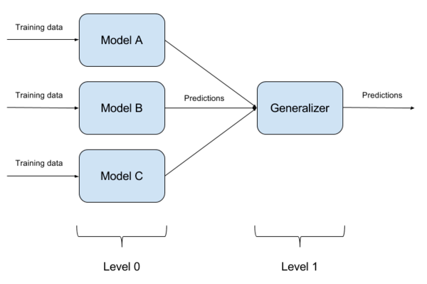
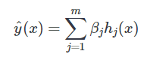
What happens during stacking?
Stacking (or stacked generalization) builds the models in the ensemble using different learning algorithms (e.g. one neural network, one decision tree, ...), as opposed to bagging or boosting that train various incarnations of the same learner (e.g. all decision trees).
The outputs of the models are combined to compute the ultimate prediction of any instance
Whereas boosting sequentially computes weights αj using an empirical formula, stacking introduces a level-1 algorithm, called meta-learner, for learning the weights βj of the level-0 predictors. That means, the m predictions of each training instance xi become now training data for the level-1 learner.
Ref 1 , Ref 2, Ref 3

Slide 32
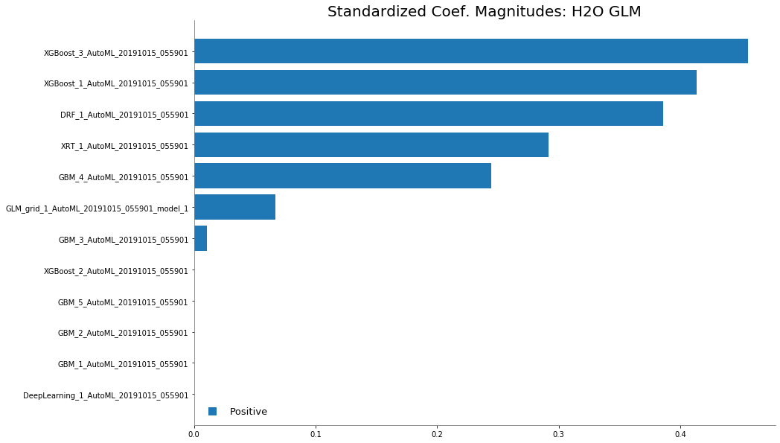
View importance of a base/meta learner in the stacked ensemble
Examine the variable importance of the metalearner (combiner) algorithm in the ensemble
%matplotlib inline
metalearner.std_coef_plot()

Slide 33
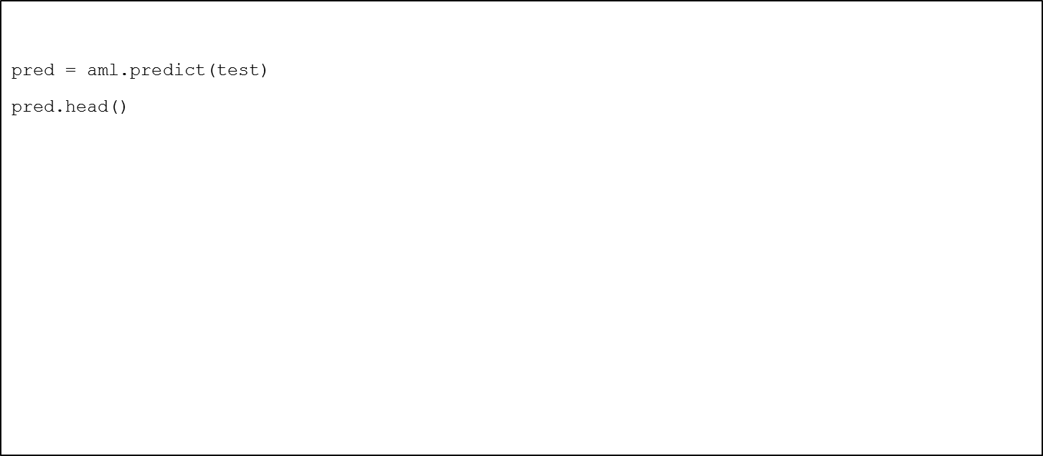
Predict on the test dataset
AutoML will automatically use the best model for prediction

Slide 34
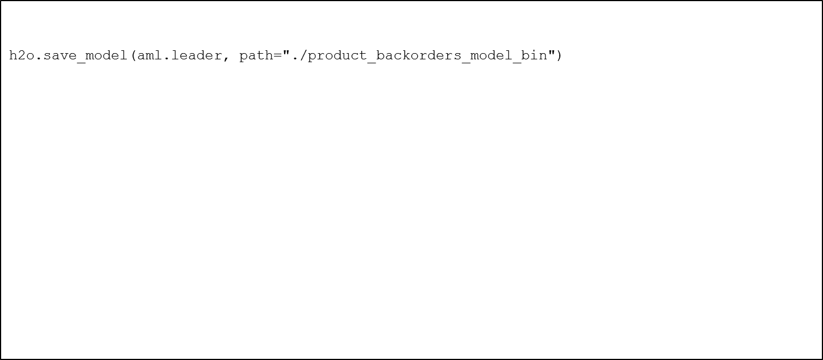
Save the best (leader) model
Save and download the leader model for deploying to production later on

Slide 35
How to interpret h2o models

Slide 36
View importance of a base/meta learner in the stacked ensemble
Examine the variable importance of the metalearner (combiner) algorithm in a stacked ensemble
bst_model = aml.leader
bst_model.std_coef_plot()

Slide 37
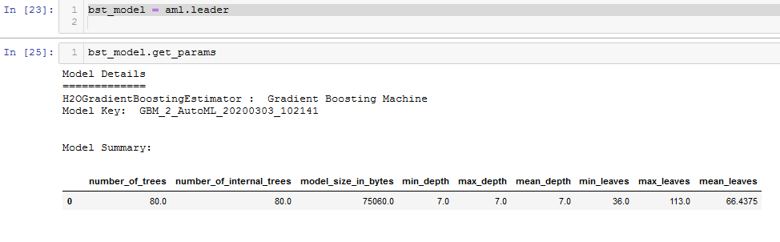
Viewing the parameters of a model
Examine the hyperparameters defined in a model
bst_model.get_params

Slide 38
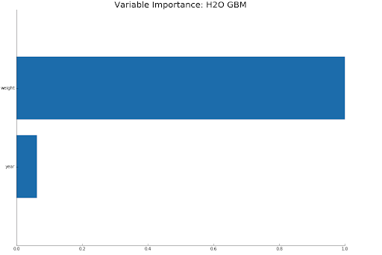
Viewing the feature importance of a model
Examine the variable importance of the metalearner (combiner) algorithm in the ensemble
bst_model.varimp_plot()

Slide 39
Explaining how a prediction is derived from the features using H2O and SHAP
Examine the features that contribute to the prediction of a particular model
DEMO
References:
Ref 1, Ref 2

Slide 40
TPOT AutoML
Documentation: https://github.com/EpistasisLab/tpot
Notes:
Resource link: https://h2o-release.s3.amazonaws.com/h2o/master/3888/docs-website/h2o-docs/downloading.html

Slide 41
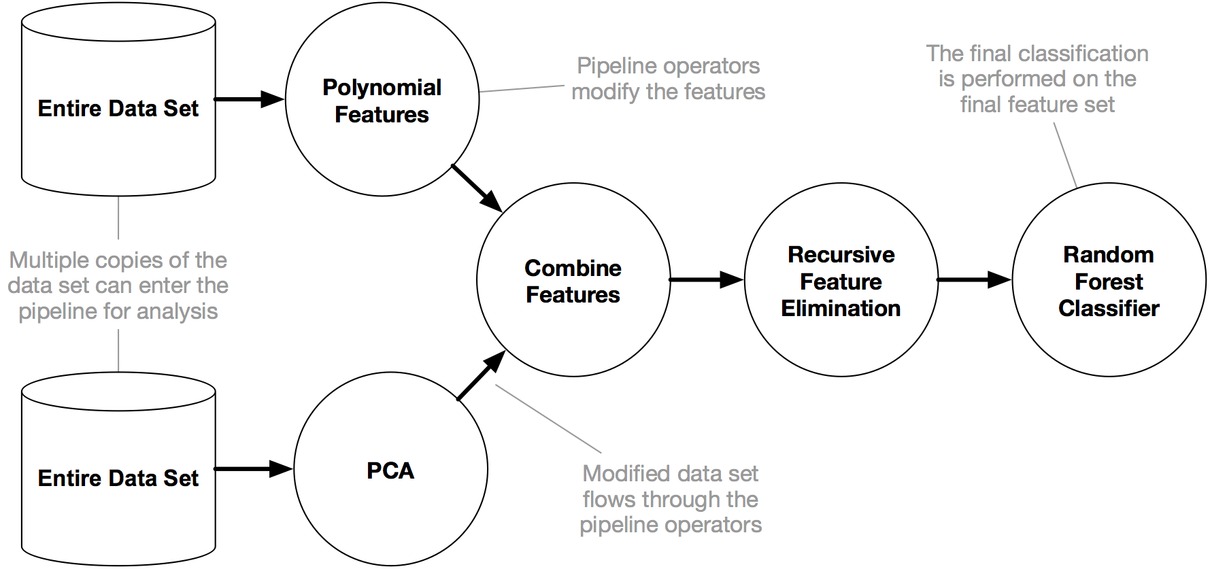
TPOT AutoML process
Reference: https://towardsdatascience.com/tpot-automated-machine-learning-in-python-4c063b3e5de9

Slide 42
Code Walkthrough
Perform Data Exploration
Convert features to numeric data type
Run TPOT and specify the stopping criterion
Save best model and view exported pipeline
*Open Jupyter Notebook Demo*

Slide 43
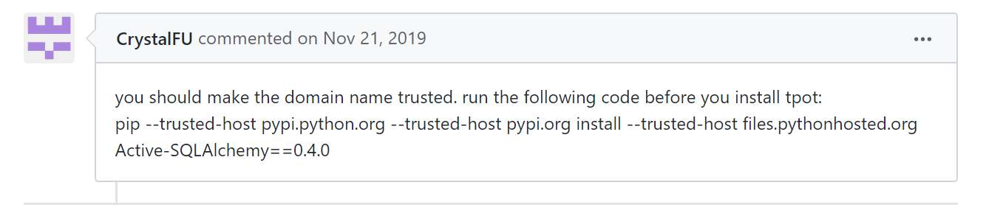
TPOT AutoML
Python Installation
TPOT
pip install tpot
conda install -c conda-forge tpot
Dependencies
conda install -c conda-forge/label/gcc7 xgboost
pip install xgboost
Notes on installation
Tested with python versions 3.6 and 3.7 Some might face issues installing with python version 3.7.
Issue tracked here: https://github.com/EpistasisLab/tpot/issues/883
Possible solution though not tested:
Notes:
Resource link: https://h2o-release.s3.amazonaws.com/h2o/master/3888/docs-website/h2o-docs/downloading.html

Slide 44
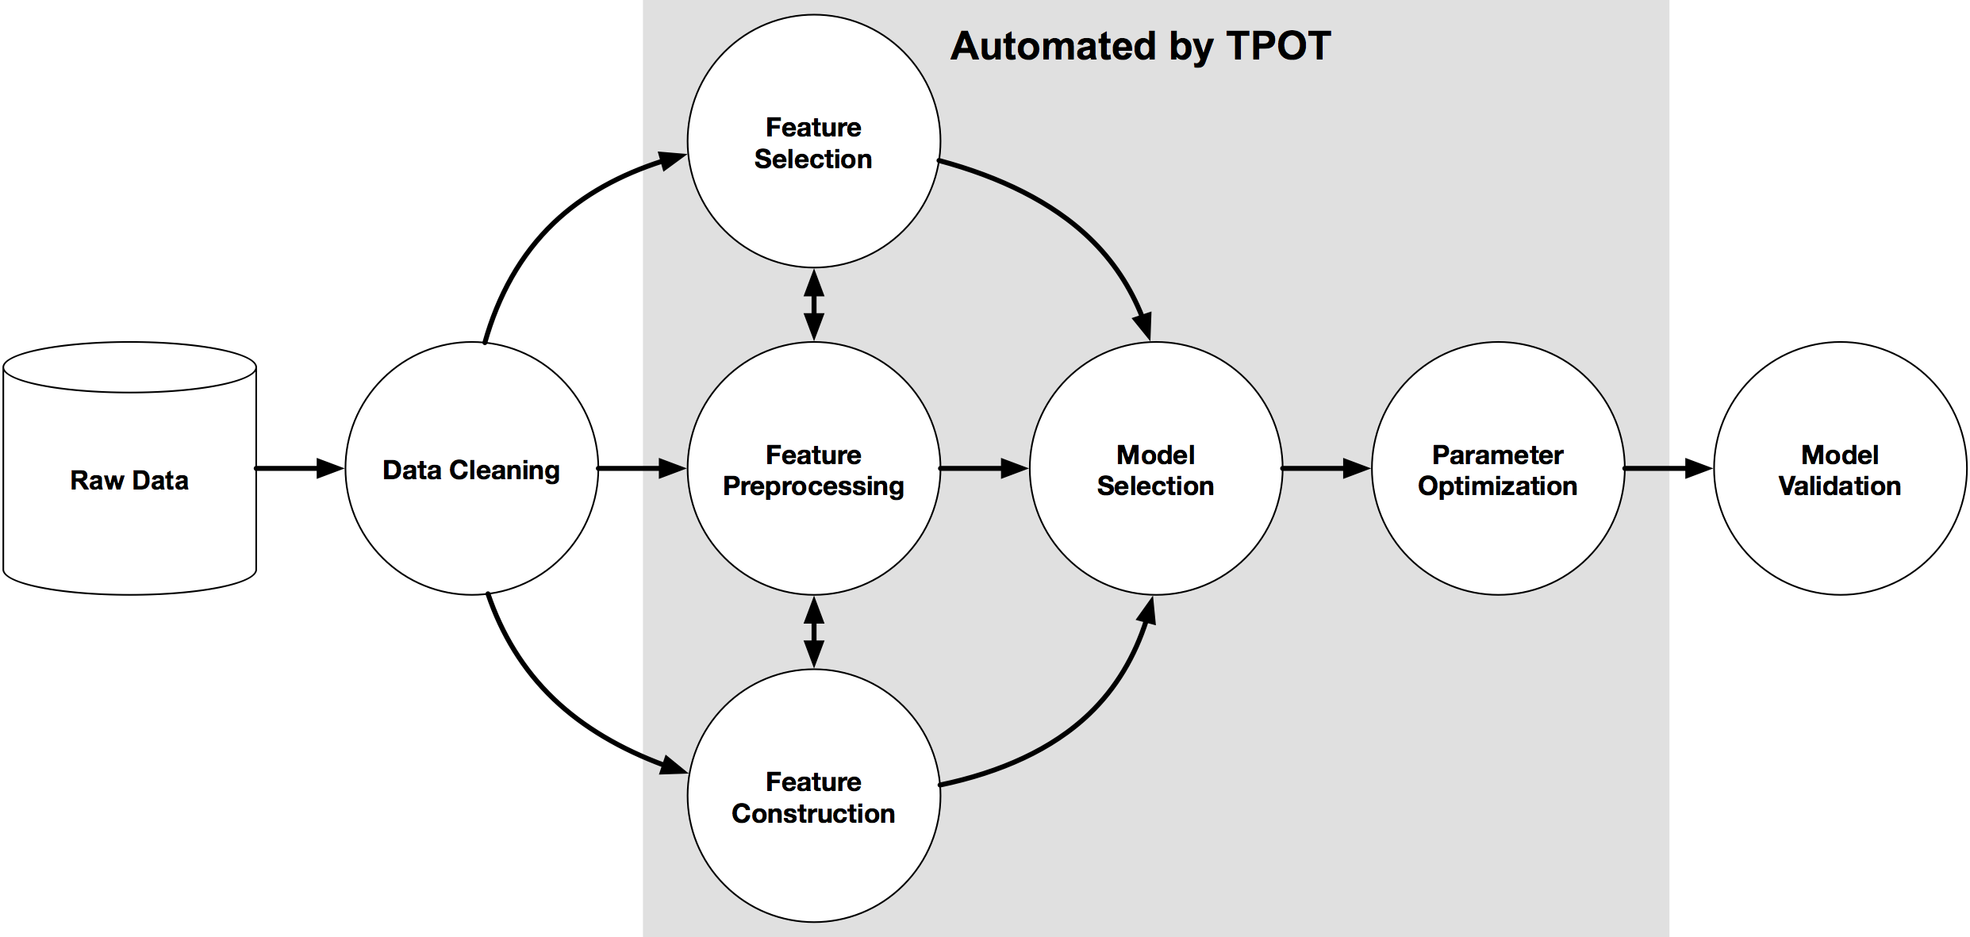
TPOT pipeline
Note: Pipelines can contain supervised classification models, preprocessors, feature selection techniques, and any other estimator or transformer that follows the scikit-learn API
What it does: Explores thousands of possible pipelines to find the best one for your data
Similar to H2O
Notes:
Resource link: https://h2o-release.s3.amazonaws.com/h2o/master/3888/docs-website/h2o-docs/downloading.html

Slide 45

TPOT pipeline
When it is done / When specified time is reached, it spits out (in python) the best pipeline it discovers which you can then tinker with.
Notes:
Resource link: https://h2o-release.s3.amazonaws.com/h2o/master/3888/docs-website/h2o-docs/downloading.html

Slide 46
Let’s try it out!
Notes:
Resource link: https://h2o-release.s3.amazonaws.com/h2o/master/3888/docs-website/h2o-docs/downloading.html

Slide 47
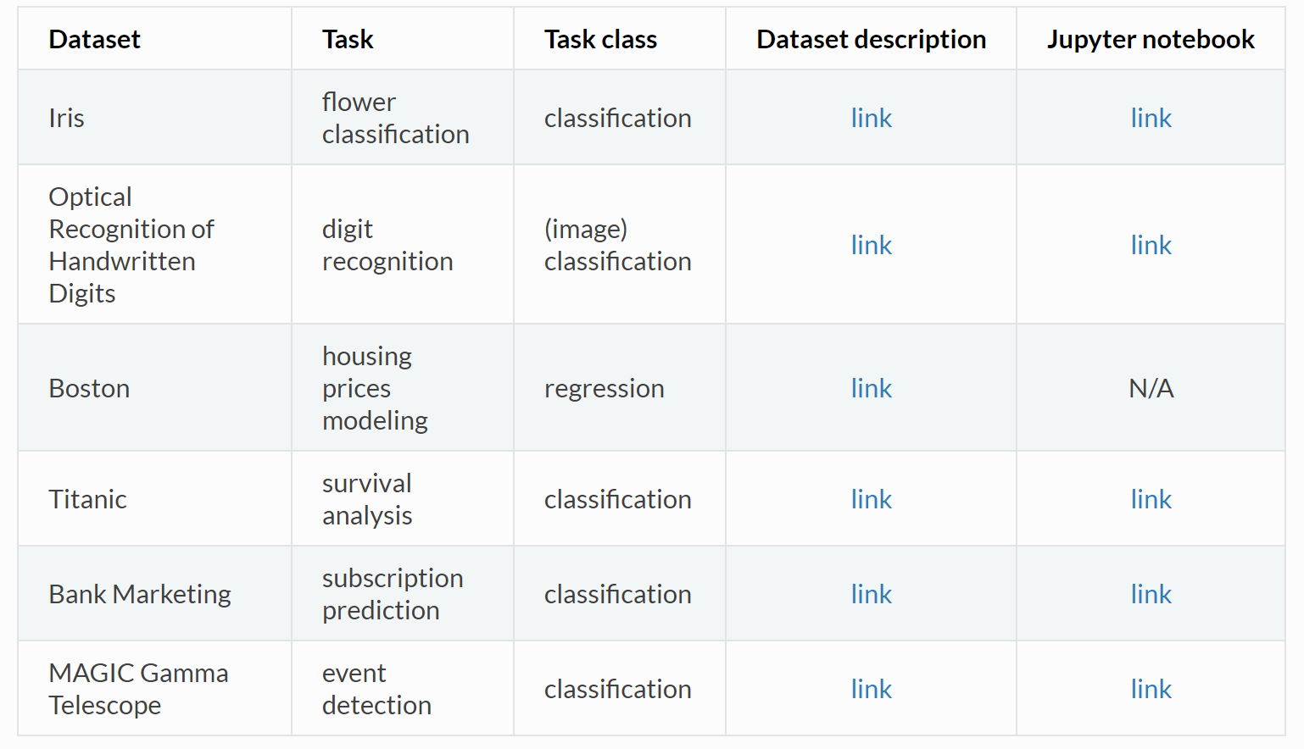
TPOT AutoML
USEFUL EXAMPLES
Examples - TPOT
Notes:
Resource link: https://h2o-release.s3.amazonaws.com/h2o/master/3888/docs-website/h2o-docs/downloading.html

Slide 48
TPOT AutoML
If I am lazy to create my own scikit-learn pipeline…
Classification
Training the TPOTClassifier
from tpot import TPOTClassifier
from sklearn.datasets import load_iris
from sklearn.model_selection import train_test_split
import numpy as np
iris = load_iris()
X_train, X_test, y_train, y_test = train_test_split(iris.data.astype(np.float64),
iris.target.astype(np.float64), train_size=0.75, test_size=0.25, random_state=42)
tpot = TPOTClassifier(generations=5, population_size=50, verbosity=2, random_state=42)
tpot.fit(X_train, y_train)
print(tpot.score(X_test, y_test))
tpot.export('tpot_iris_pipeline.py')
Exported Pipeline
import numpy as np
import pandas as pd
from sklearn.model_selection import train_test_split
from sklearn.neighbors import KNeighborsClassifier
from sklearn.pipeline import make_pipeline
from sklearn.preprocessing import Normalizer
from tpot.export_utils import set_param_recursive
# NOTE: Make sure that the outcome column is labeled 'target' in the data file
tpot_data = pd.read_csv('PATH/TO/DATA/FILE', sep='COLUMN_SEPARATOR', dtype=np.float64)
features = tpot_data.drop('target', axis=1)
training_features, testing_features, training_target, testing_target = \
train_test_split(features, tpot_data['target'], random_state=42)
# Average CV score on the training set was: 0.9826086956521738
exported_pipeline = make_pipeline(
Normalizer(norm="l2"),
KNeighborsClassifier(n_neighbors=5, p=2, weights="distance")
)
# Fix random state for all the steps in exported pipeline
set_param_recursive(exported_pipeline.steps, 'random_state', 42)
exported_pipeline.fit(training_features, training_target)
results = exported_pipeline.predict(testing_features)
3. Export python code for the optimized pipeline
tpot.fit() initializes the genetic programming algorithm to find the highest-scoring pipeline based on average k-fold cross-validation
tpot.score() evaluates the final pipeline on the testing set.
Notes:
Resource link: https://h2o-release.s3.amazonaws.com/h2o/master/3888/docs-website/h2o-docs/downloading.html

Slide 49
Further Resources
Case Studies: 22 AutoML Case Studies / Examples: In-Depth Guide [2020]
Limitations of AutoML: https://www.kdnuggets.com/2019/03/why-automl-wont-replace-data-scientists.html
Reviewing different AutoML frameworks:
Automate Your ML Model Tuning and Selection Using AutoML in Python
Choosing the best AutoML Framework - Georgian Impact Blog
H2O
H2O Tutorial in R and Python : h2o-tutorials/h2o-world-2017/automl at master · h2oai/h2o-tutorials
Kaggle Example: https://www.kaggle.com/paradiselost/tutorial-automl-capabilities-of-h2o-library
AutoML Pro Tips: https://www.slideshare.net/0xdata/scalable-automatic-machine-learning-in-h2o-89130971
TPOT
Framework: TPOT: A Python Tool for Automating Data Science
TPOT VS H2O: Automate Your ML Model Tuning and Selection Using AutoML in Python
Research Papers:
Methods for Improving Bayesian Optimization for AutoML
Bayesian Hyperparameter Optimization for Ensemble Learning

Slide 50
Thank you

